Slide 1
Hopkins Auditory Comprehension with Context Assessment (HACCA)

Slide 2
Part I: Sentence-Picture Matching Trial 1

Slide 3
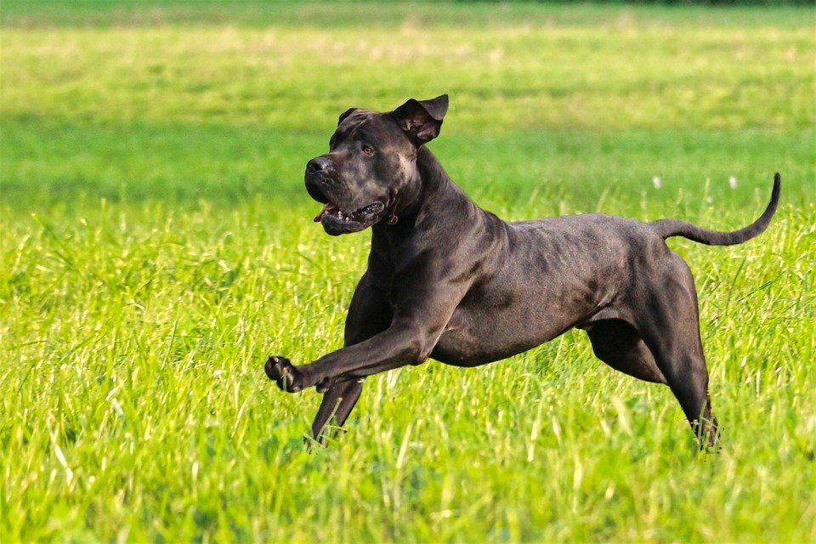
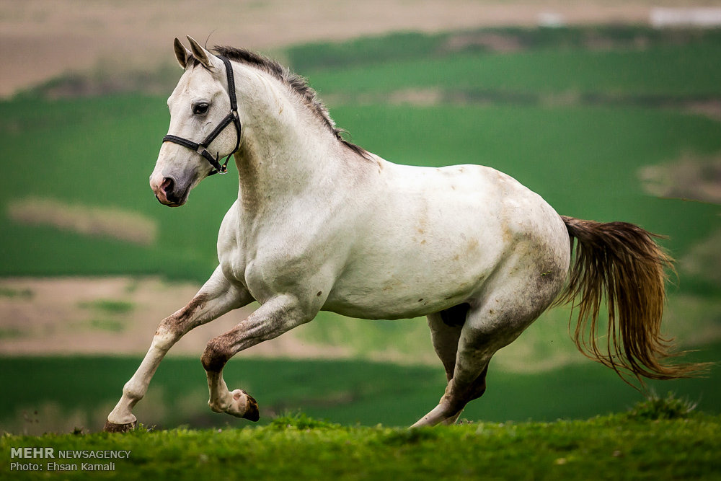
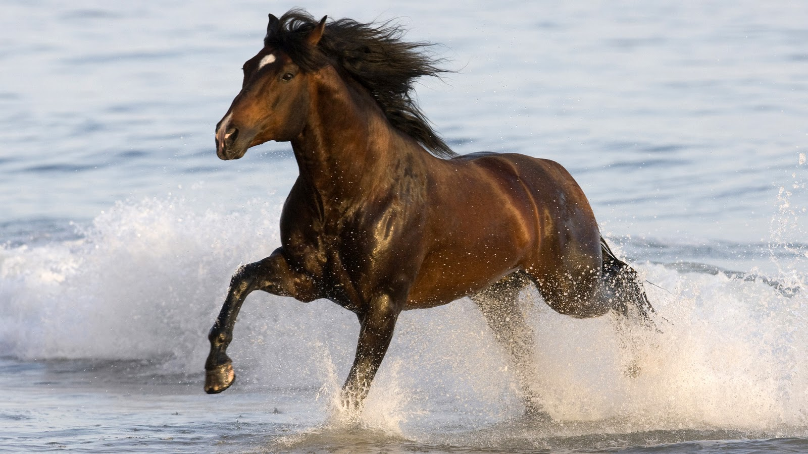
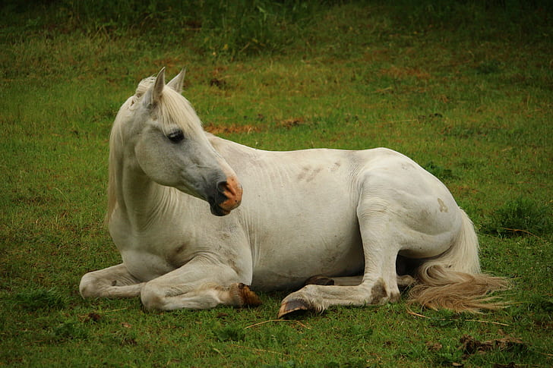
1
2
3
4
P1

Slide 4
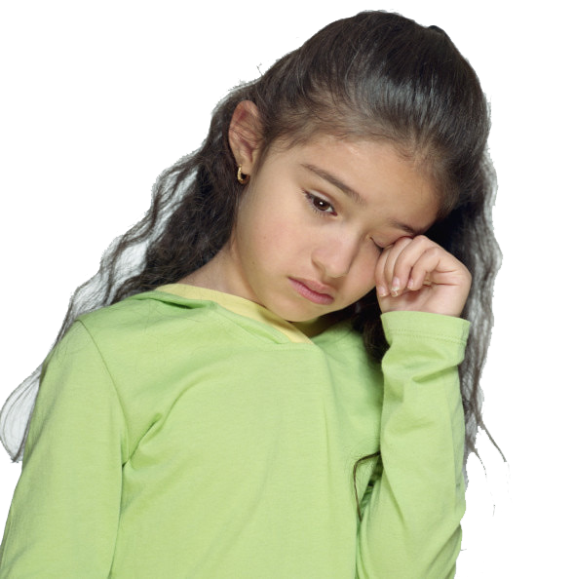
1
2
3
4
P2
This Photo by Unknown Author is licensed under CC BY-NC

Slide 5
1
2
3
4
1

Slide 6
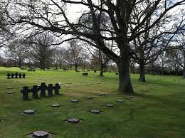
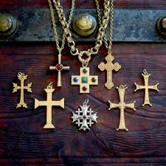
1
2
3
4
2

Slide 7
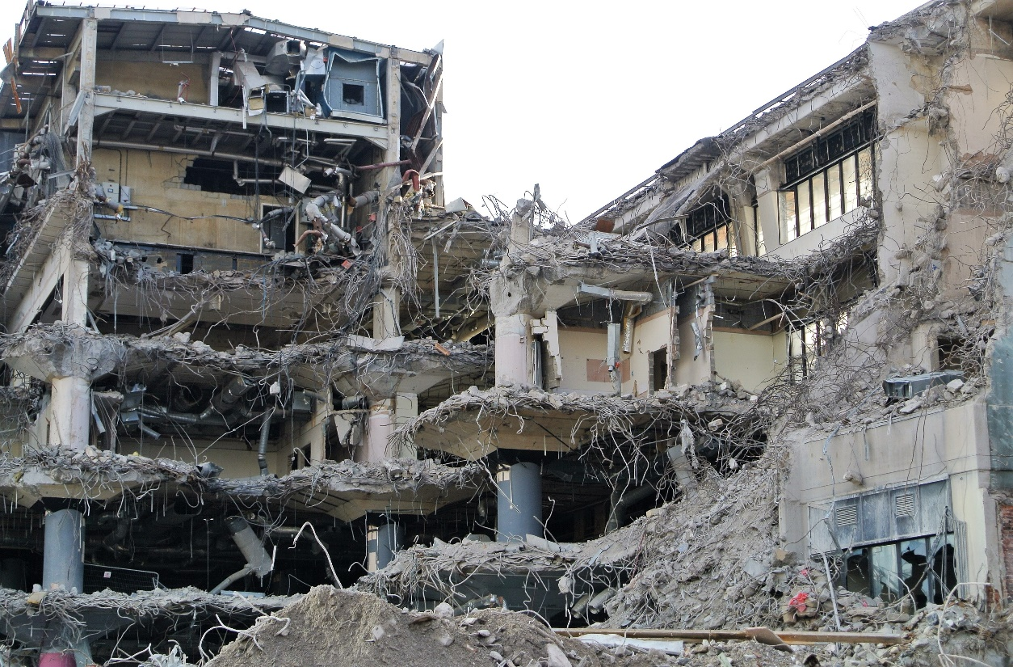
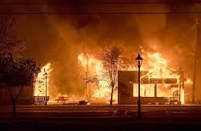
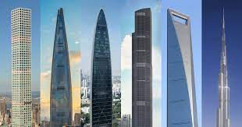
1
2
3
4
3

Slide 8
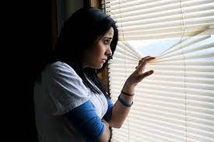
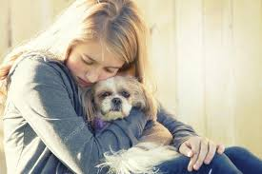
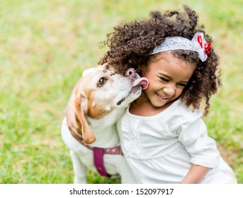
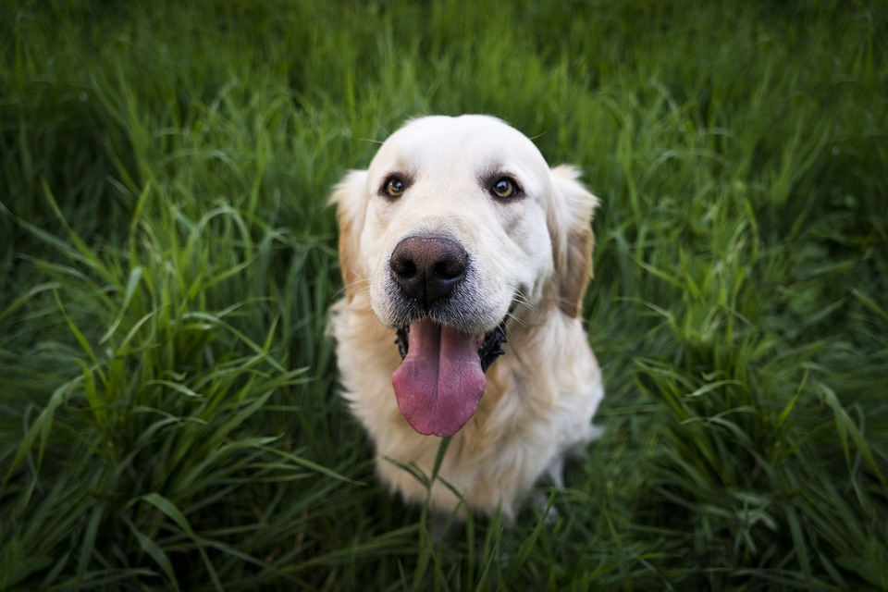
1
2
3
4
4

Slide 9
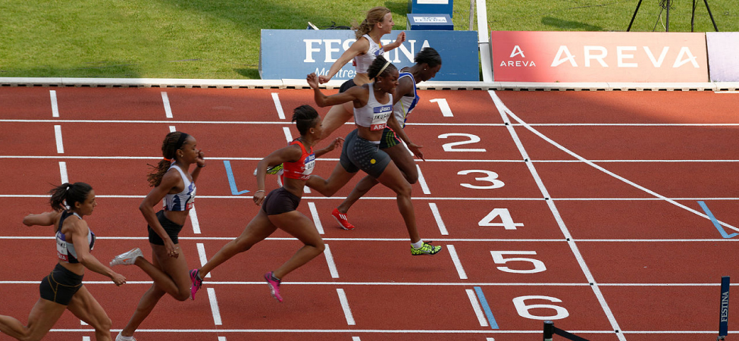
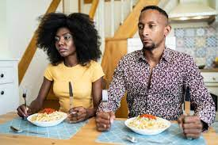
1
2
3
4
5

Slide 10
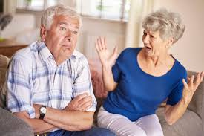
1
2
3
4
6

Slide 11
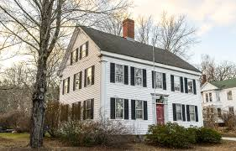
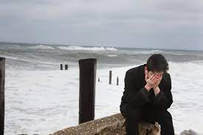
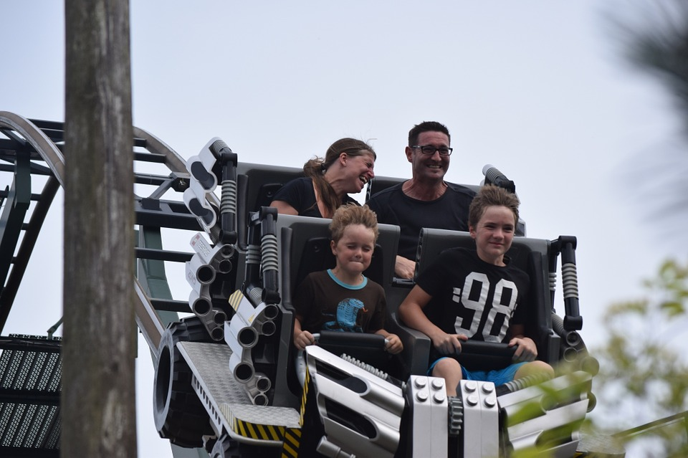
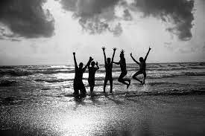
1
2
3
4
7

Slide 12
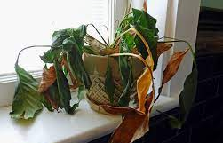
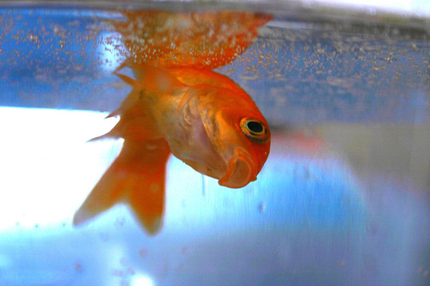
1
2
3
4
8

Slide 13
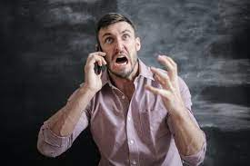
1
2
3
4
9

Slide 14
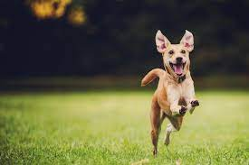
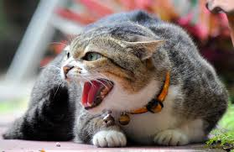
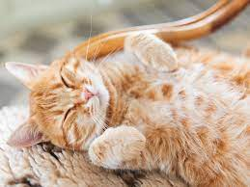
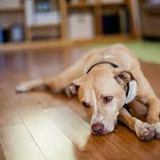
1
2
3
4
10

Slide 15
Part I: Sentence-Picture Matching Trial 2

Slide 16
1
2
3
4
1

Slide 17
1
2
3
4
2

Slide 18
1
2
3
4
3

Slide 19
1
2
3
4
4

Slide 20
1
2
3
4
5

Slide 21
1
2
3
4
6

Slide 22
1
2
3
4
7

Slide 23
1
2
3
4
8

Slide 24
1
2
3
4
9

Slide 25
1
2
3
4
10

Slide 26
Part I: Sentence-Picture Matching Trial 3

Slide 27
1
2
3
4
1

Slide 28
1
2
3
4
2

Slide 29
1
2
3
4
3

Slide 30
1
2
3
4
4

Slide 31
1
2
3
4
5

Slide 32
1
2
3
4
6

Slide 33
1
2
3
4
7

Slide 34
1
2
3
4
8

Slide 35
1
2
3
4
9

Slide 36
1
2
3
4
10

Slide 37
Part II: Spoken Commands Trial 1

Slide 38
Part II: Spoken Commands Trial 2

