Slide 1
Modified Hopkins Auditory Comprehension with Context Assessment
(mHACCA)

Slide 2
Sentence-Picture Matching
Practice

Slide 3
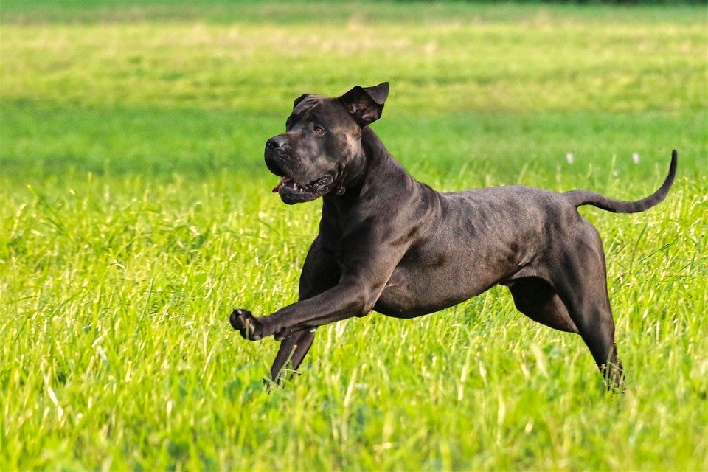
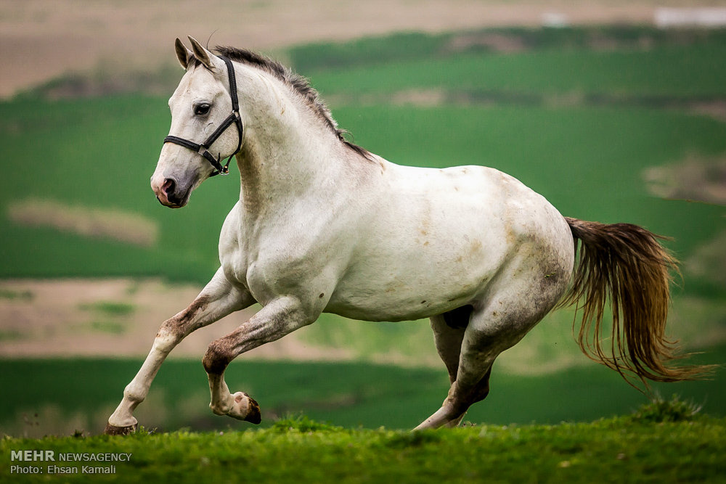


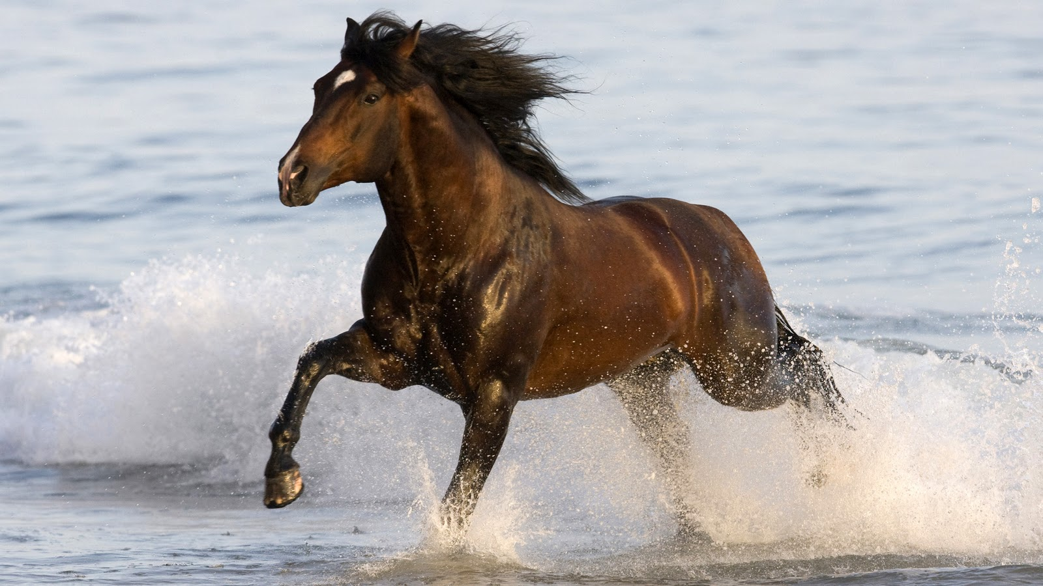
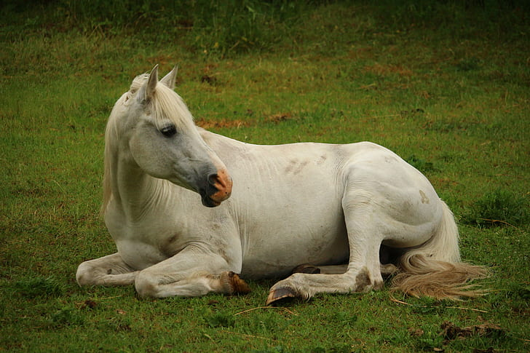
1
2
3
4
P1

Slide 4




1
2
3
4
P2
This Photo by Unknown Author is licensed under CC BY-NC

Slide 5
Part I: Sentence-Picture Matching

Slide 6
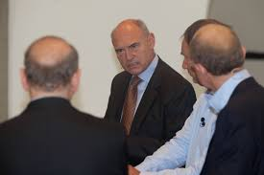


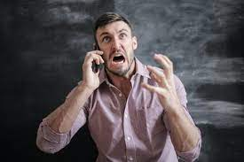
1
2
3
4

Slide 7

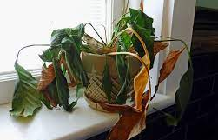


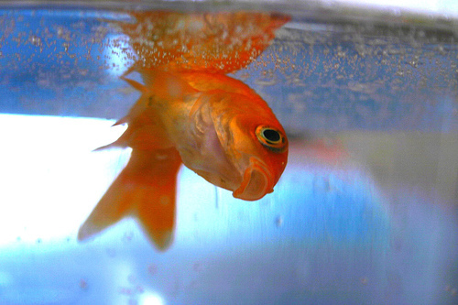
1
2
3
4

Slide 8
1
2
3
4

Slide 9
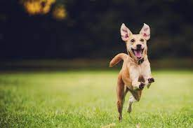
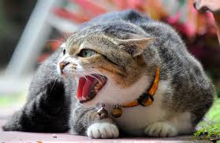
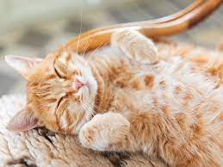
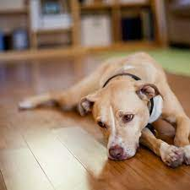
1
2
3
4

Slide 10


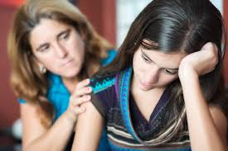

1
2
3
4

Slide 11
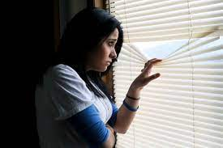
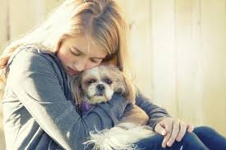
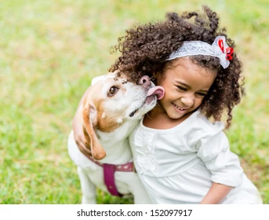
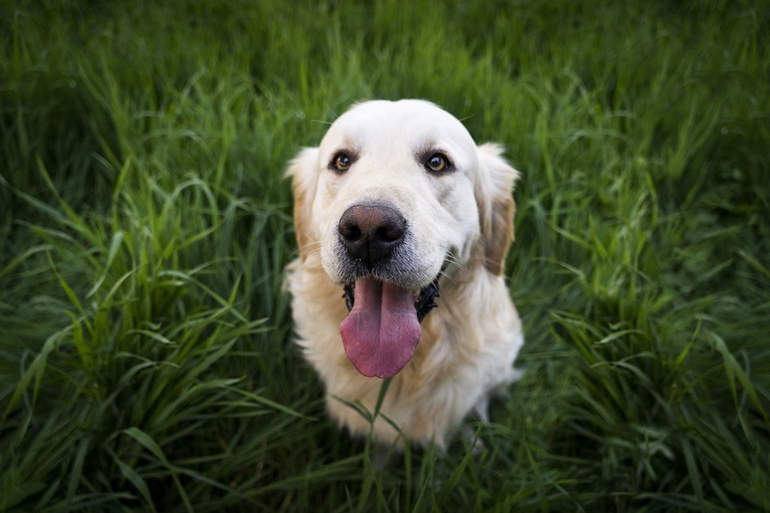
1
2
3
4

Slide 12
1
2
3
4

Slide 13


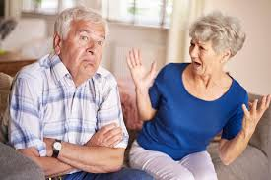

1
2
3
4

Slide 14

1
2
3
4

Slide 15
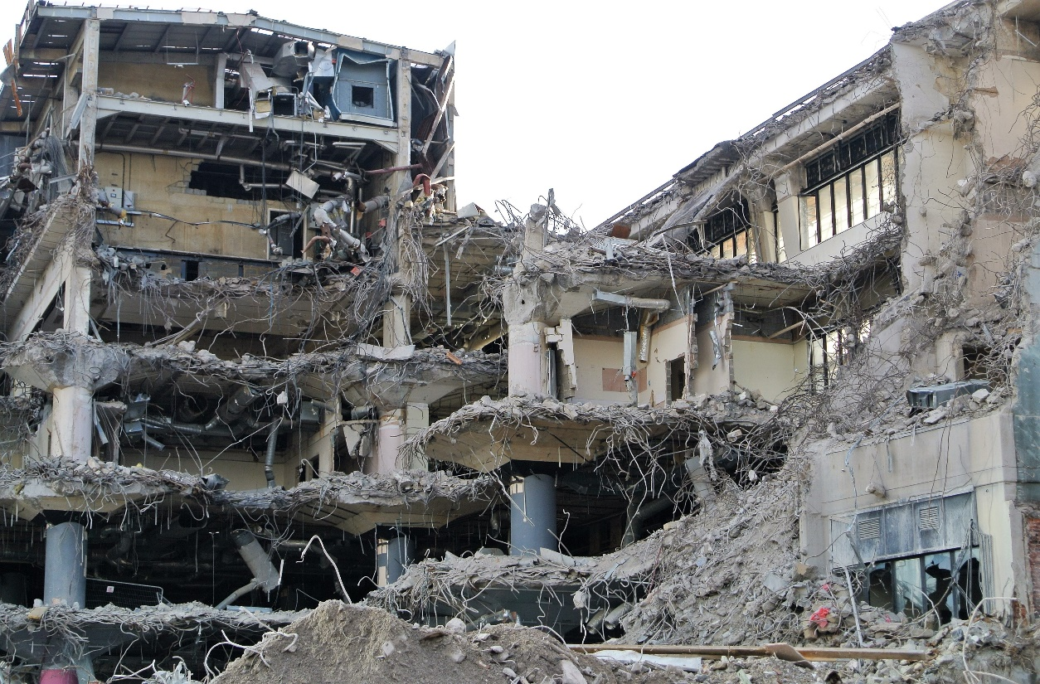


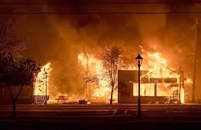
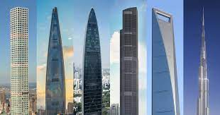
1
2
3
4

Slide 16
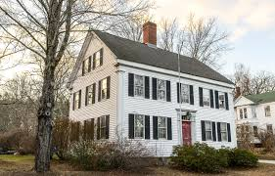
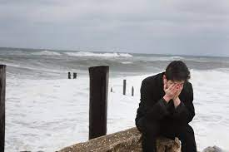
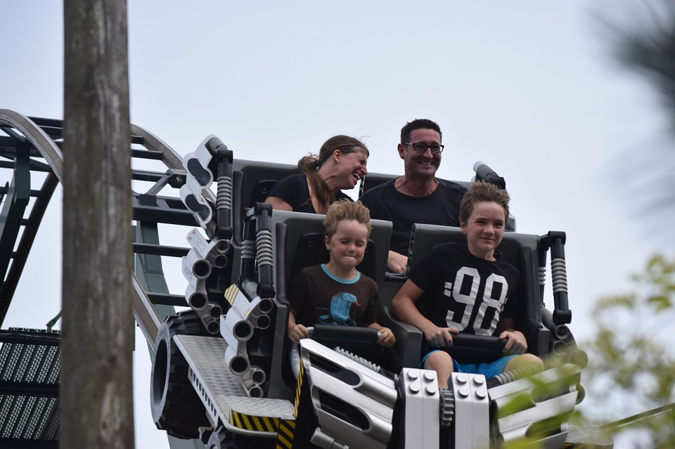
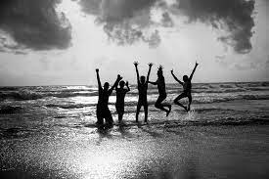
1
2
3
4

Slide 17
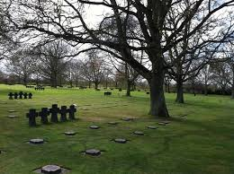
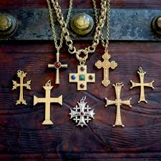


1
2
3
4

Slide 18
1
2
3
4

Slide 19
1
2
3
4

Slide 20
1
2
3
4

Slide 21
1
2
3
4

Slide 22
1
2
3
4

Slide 23
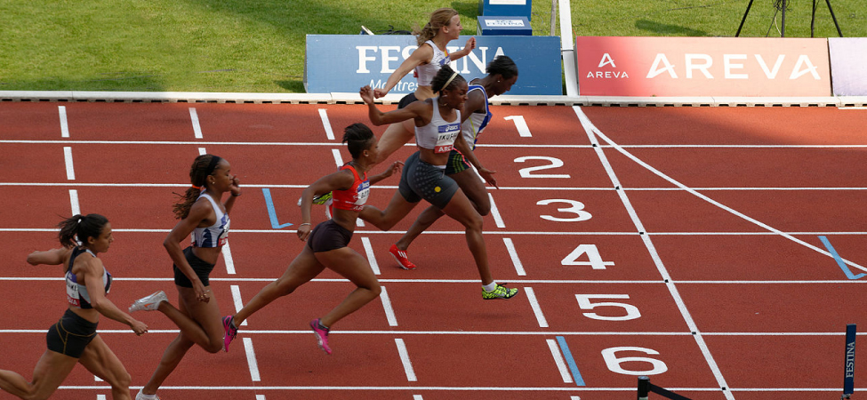

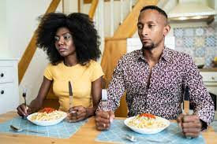

1
2
3
4

Slide 24
1
2
3
4

Slide 25
1
2
3
4

Slide 26
1
2
3
4

Slide 27
1
2
3
4

Slide 28
1
2
3
4

Slide 29
1
2
3
4

Slide 30
1
2
3
4

Slide 31
1
2
3
4

Slide 32
1
2
3
4

Slide 33
1
2
3
4

Slide 34
1
2
3
4

Slide 35
1
2
3
4

Slide 36
Part II: Spoken Commands

